Slide 1
PROJECT REPORT OF SUMMER
INTERSHIP
TOPIC:-
SOP for gst
Submitted to:- Shashwat Singhal
Submitted by:-Unnati Chaurasia

Slide 2
WHAT IS GST ?
GST (Goods and Services Tax) is an indirect tax levied on the supply of goods and services in India. It was introduced on 1 July 2017 to replace multiple indirect taxes such as VAT, Service Tax, Excise Duty, and others with a single unified tax system.
Types of GST: -
CGST: - Central Goods and Services Tax.
SGST: - States Goods and Services Tax.
IGST: - Integrated Goods and Services Tax.
UTGST: - Union Territory Goods and Services Tax.

Slide 3
STANDARD OPERATING PROCEDURE
A Standard Operating Procedure (SOP) is a documented set of step-by-step instructions that explains how a specific task or process should be performed. It helps ensure that work is carried out in a consistent, accurate, and efficient manner every time. SOPs are used by organizations to maintain quality standards, reduce errors, improve productivity, and ensure compliance with policies and regulations. In research projects, SOPs provide clear guidelines for conducting research activities, collecting data, analysing information, and preparing reports systematically.

Slide 4
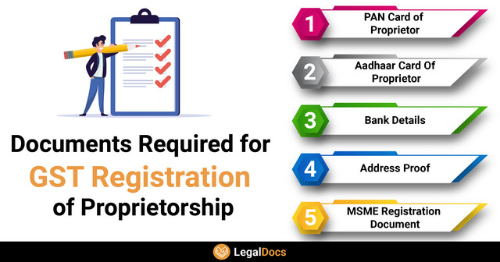
SOP for
GST Registration
Collect necessary documents.
Visit GST Portal.
Fill registration form.
Verify mobile number and email.
Upload supporting documents.
Submit application.
Receive GSTIN after approval.
Documents Required: -
PAN Card
Aadhaar Card
Business Address Proof
Bank Account Details
Passport-size Photograph

Slide 5
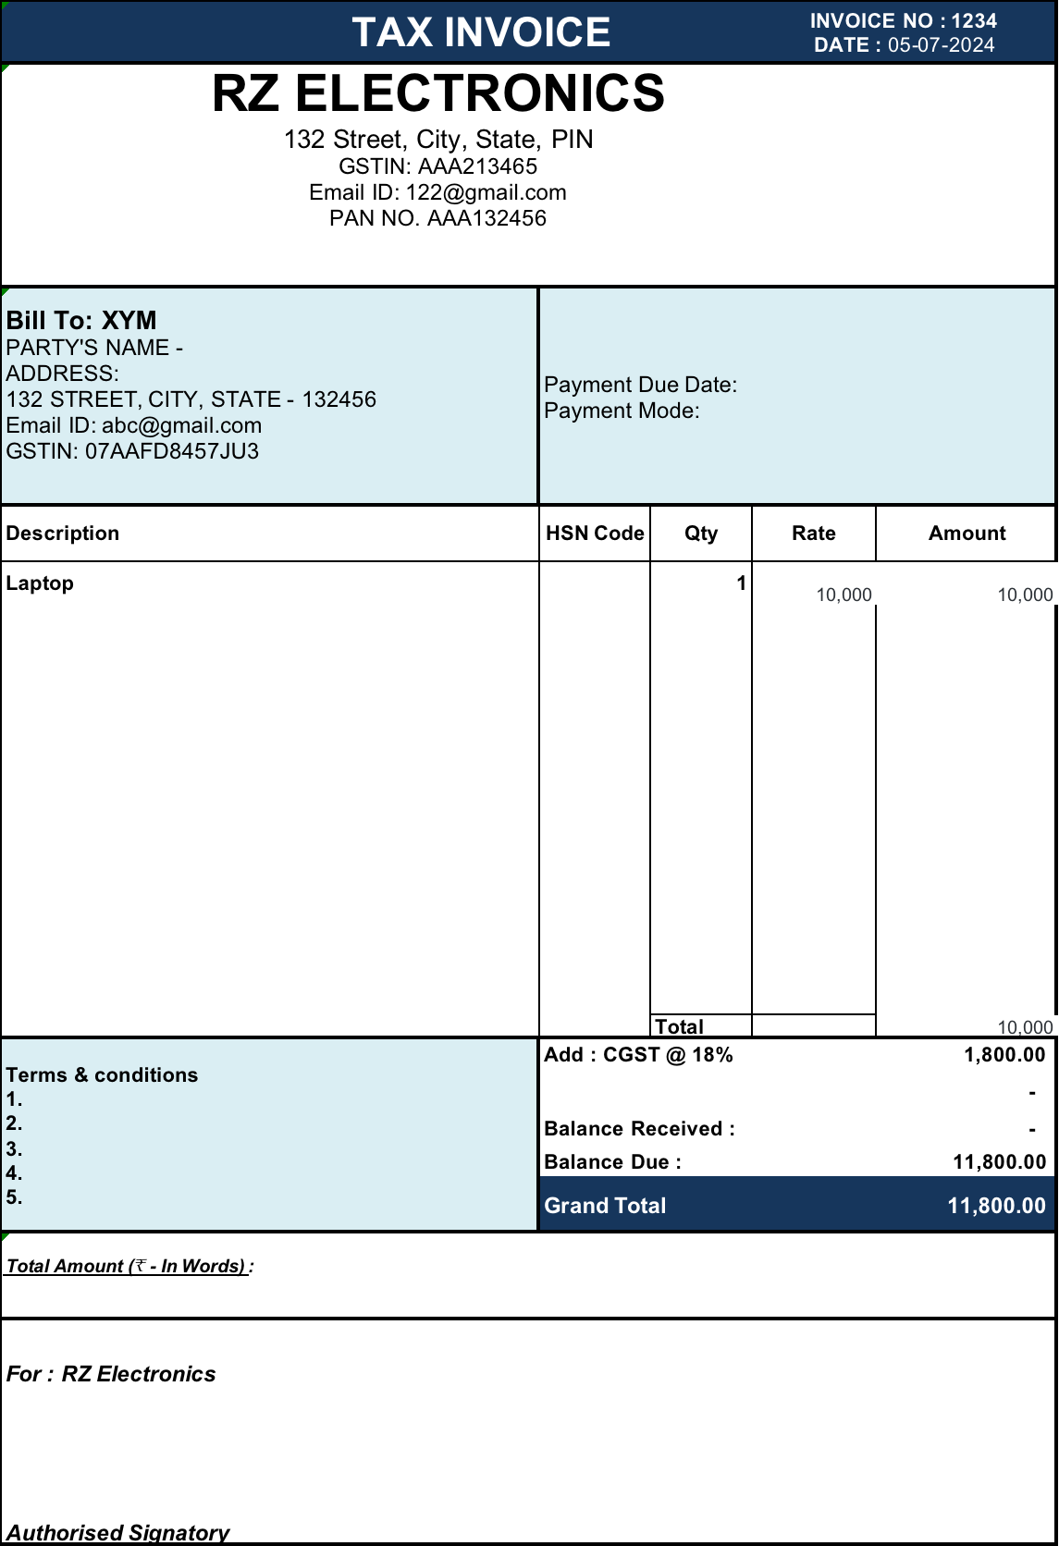
SOP for Tax Invoice Preparation: -
Procedures: -
Generate invoice number.
Enter supplier details.
Enter customer details.
Mention GSTIN.
Calculate taxable value.
Apply GST rate.
Mention total invoice value.
Issue invoice.

Slide 6
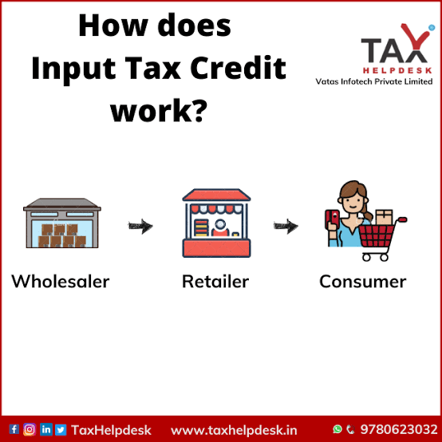
SOP for Input Tax Credit (ITC): -
Procedures: -
Verify purchase invoices.
Match invoices with GSTR-2B.
Confirm supplier has filed returns.
Verify eligibility of ITC.
Claim ITC in GSTR-3B.

Slide 7
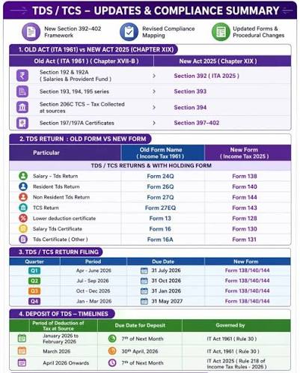
SOP for Filing TDS Return
Collect TDS Information
Deposit TDS.
Prepare TDS Return
Validate the Return
Generate Return File
Upload the TDS Return
Verify Submission Status
Download and Issue TDS Certificates

Slide 8
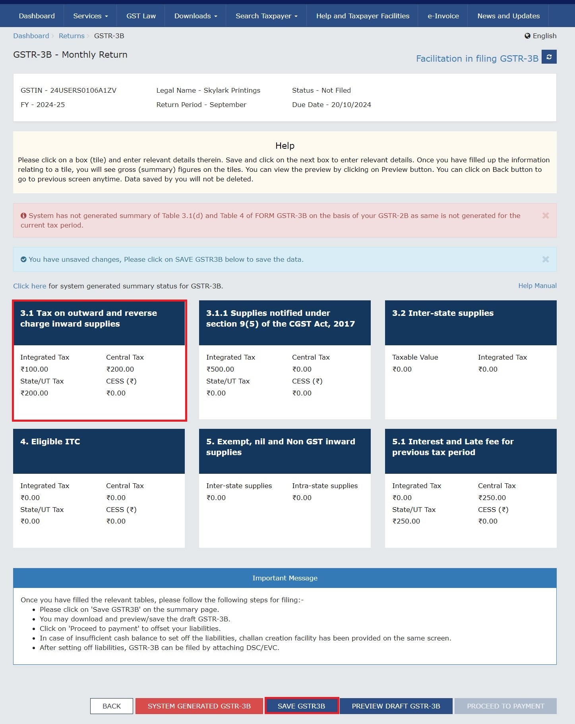
SOP for Filing GSTR-3B
Collect and Verify GST Data
Calculate GST Liability
Determine Input Tax Credit (ITC)
Login to GST Portal
Select Return Period
Enter Return Details
Offset Tax Liability
Preview and Verify Return
File GSTR-3B
Download Acknowledgment

Slide 9
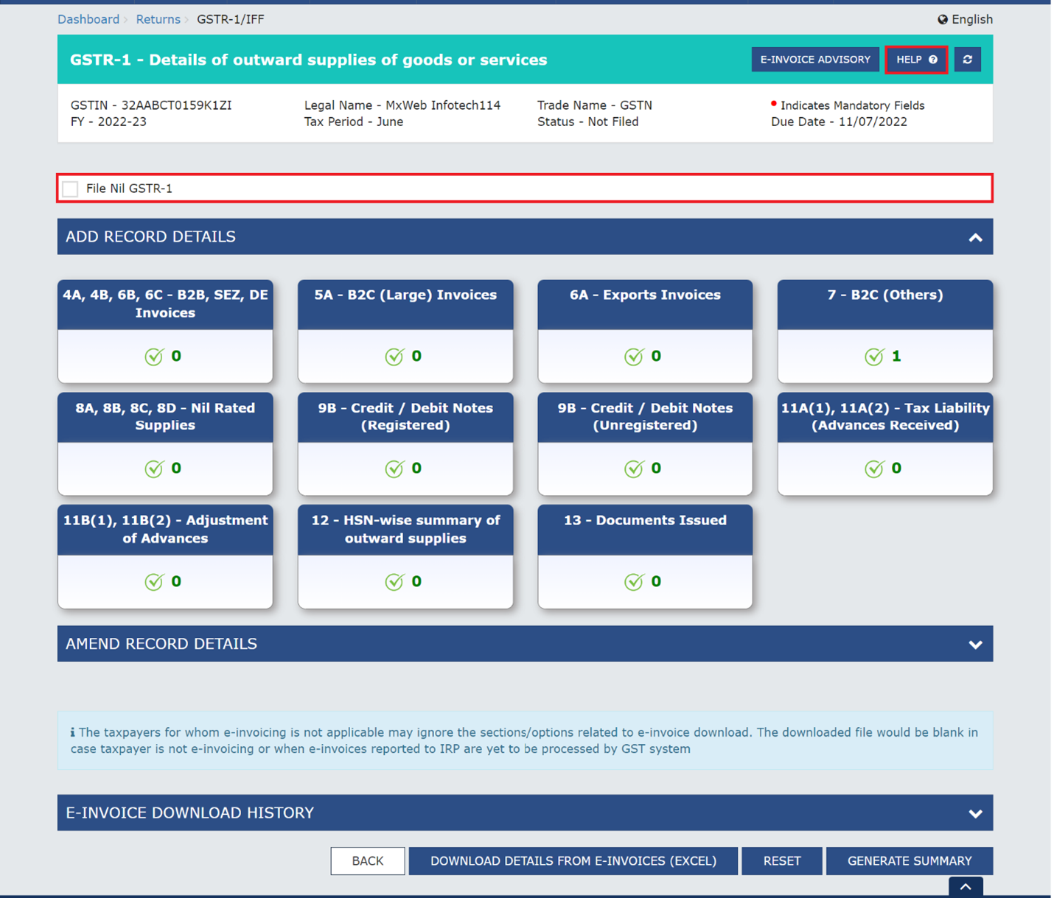
SOP for Filing GSTR-1
Collect Sales Data
Reconcile Sales Records
Login to GST Portal
Select Return Period
Enter Outward Supply Details
Validate Data
Generate Summary
Submit GSTR-1
File Return
Download Acknowledgment

Slide 10
CONCLUSION
Standard Operating Procedures (SOPs) are essential for ensuring that tasks are performed in a systematic, accurate, and efficient manner. They help standardize processes, improve productivity, reduce errors, maintain compliance with laws and regulations, and ensure consistent results. In areas such as research, taxation, and GST compliance, SOPs provide clear guidelines that enhance accuracy, transparency, and accountability. Proper implementation of SOPs helps organizations and individuals achieve their objectives effectively, maintain quality standards, and ensure smooth and reliable operations.

